Slide 1
Try to find something from World Development Dataset
Guang Qiu
12/2/2018

Slide 2
Data source and description
Agricultural machinery, tractors
Fertilizer consumption (kilograms per hectare of arable land)
Agricultural land (sq. km)
Arable land (hectares)
Land under cereal production (hectares)
Forest area (sq. km)
Land area (sq. km)
Rural land area (sq. km)
Agricultural machinery, tractors per 100 sq. km of arable land
……
Topics
Agriculture and Food Security
Climate Change
Economic Growth
Education
Energy and Extractives
Environment and Natural Resources
Financial Sector Development
Gender
Health, Nutrition and Population
Macroeconomic Vulnerability and Debt
Poverty
Private Sector Development
Public Sector Management
Social Development
Social Protection and Labor
Trade
Urban Development
1600 attributes * 264 countries/regions * 58 years
Notes:
The primary World Bank collection of development indicators, compiled from officially-recognized international sources. It presents the most current and accurate global development data available, and includes national, regional and global estimates

Slide 3
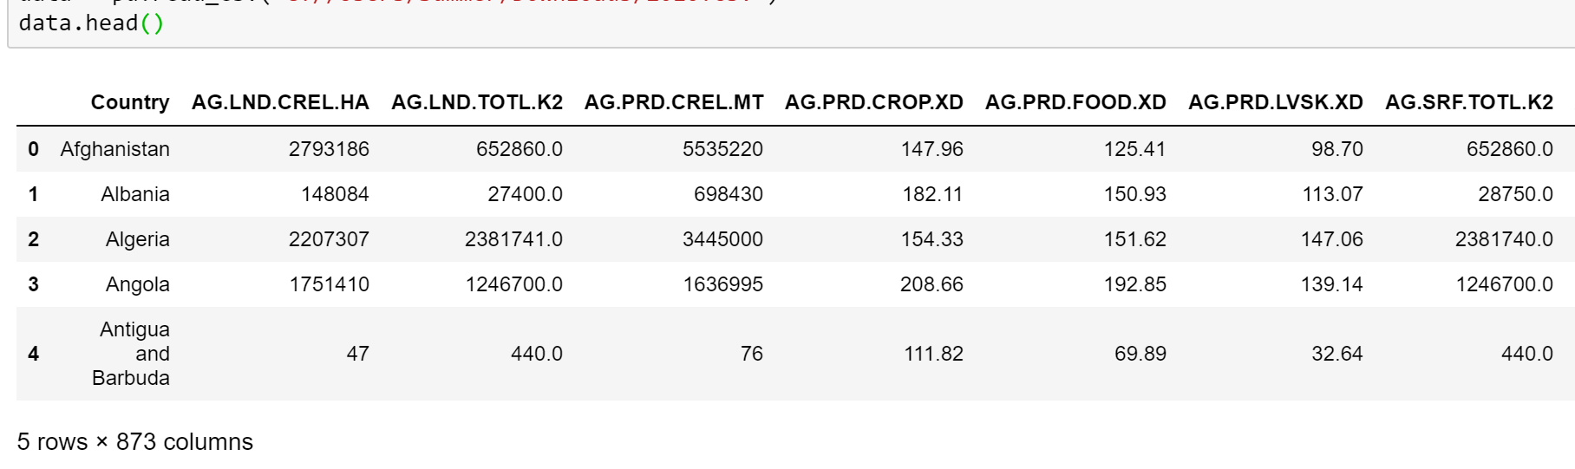
Data source and description
2016 was chosen.
Deal with missing values:
*For a country/region or one variable, it was deleted if it had more than 50% missing values.
*The blank was replaced by the average.
262 countries/regions * 872 variables = 228,464

Slide 4
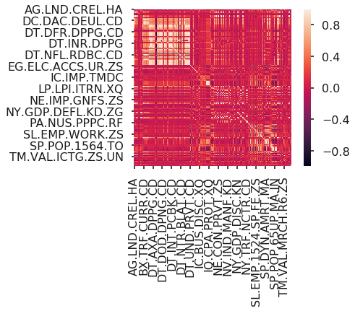
Agricultural
Financial Sector Development
Power
GDP
Labor force
Land under cereal production (hectares)
Net bilateral aid flows from DAC donors, Germany (current US$)
Debt forgiveness or reduction (current US$)
Access to electricity, rural (% of rural population)
Wage and salaried workers, female (% of female employment)
People’s Income

Slide 5

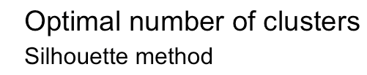

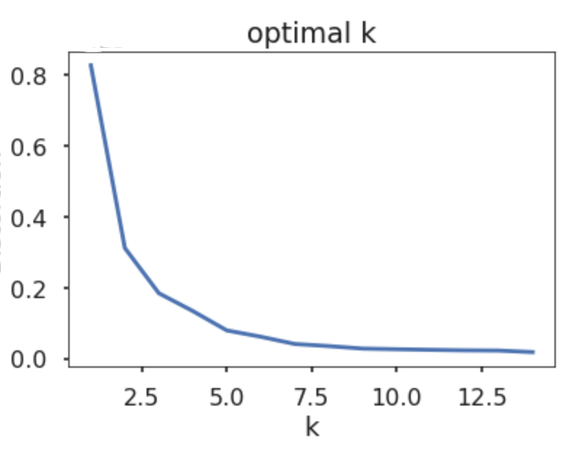
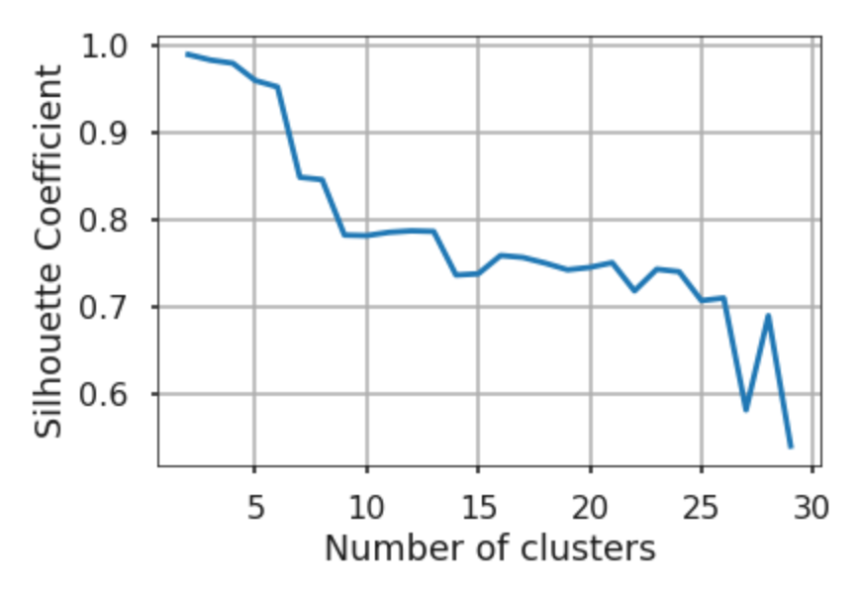
K-means clustering

Slide 6
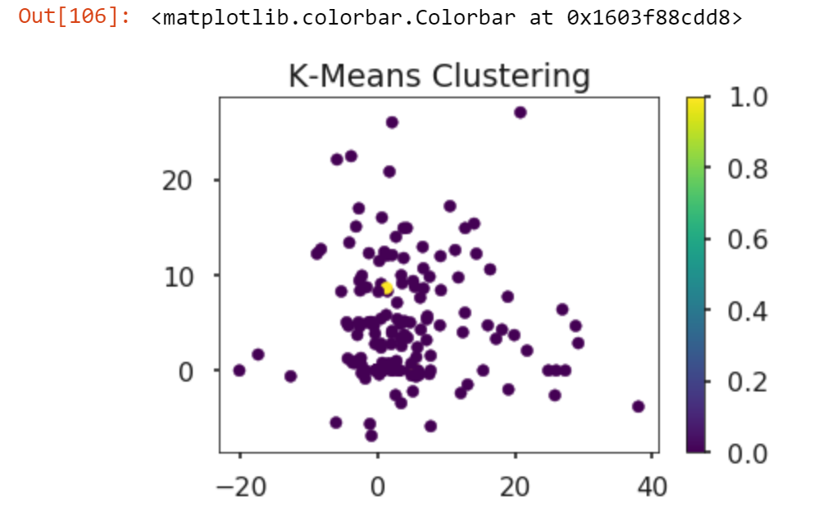
K-means clustering
Optimal number of clusters = 2

Slide 7
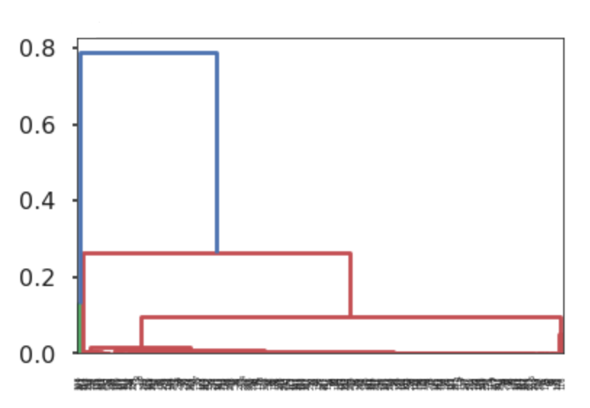
Hierarchical clustering

Slide 8
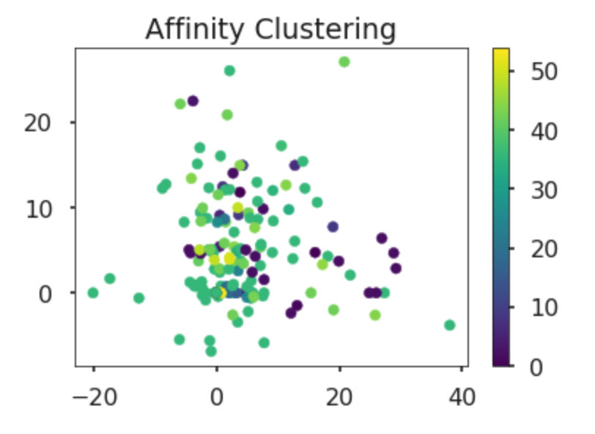

Slide 9
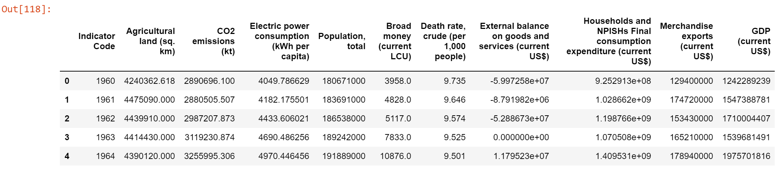
Data description
United States was chosen.
Deal with missing values:
Deleted

Slide 10
Split data & Results
Since the data was not enough.
75%(1960-2002) -> training data
25%(2003-2017) -> testing data
 | Training Score | Testing Score
Logistic Regression | 0.94 | 0.93
KNN Regression(k=5) | 0.89 | 0.93
Random Forest Regressor | 0.98 | 0.95
Decision Tree Regressor | 0.98 | 0.95
Lasso Regression | 0.93 | 0.94
Ridge Regression | 0.92 | 0.93

Slide 11
Supervised learning is where you have input variables (X) and an output variable (y) and you use an algorithm to learn the mapping function from the input to the output.
A time series where the observations are uniform over time may be described as contiguous. Many time series problems have contiguous observations, such as one observation each hour, day, month or year.
x x1 … y y1
0
1
2
3
…
time x
…

Slide 12
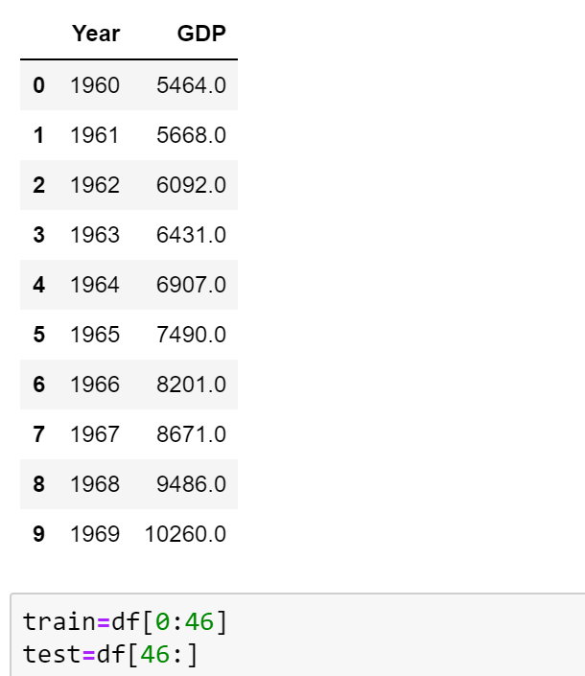
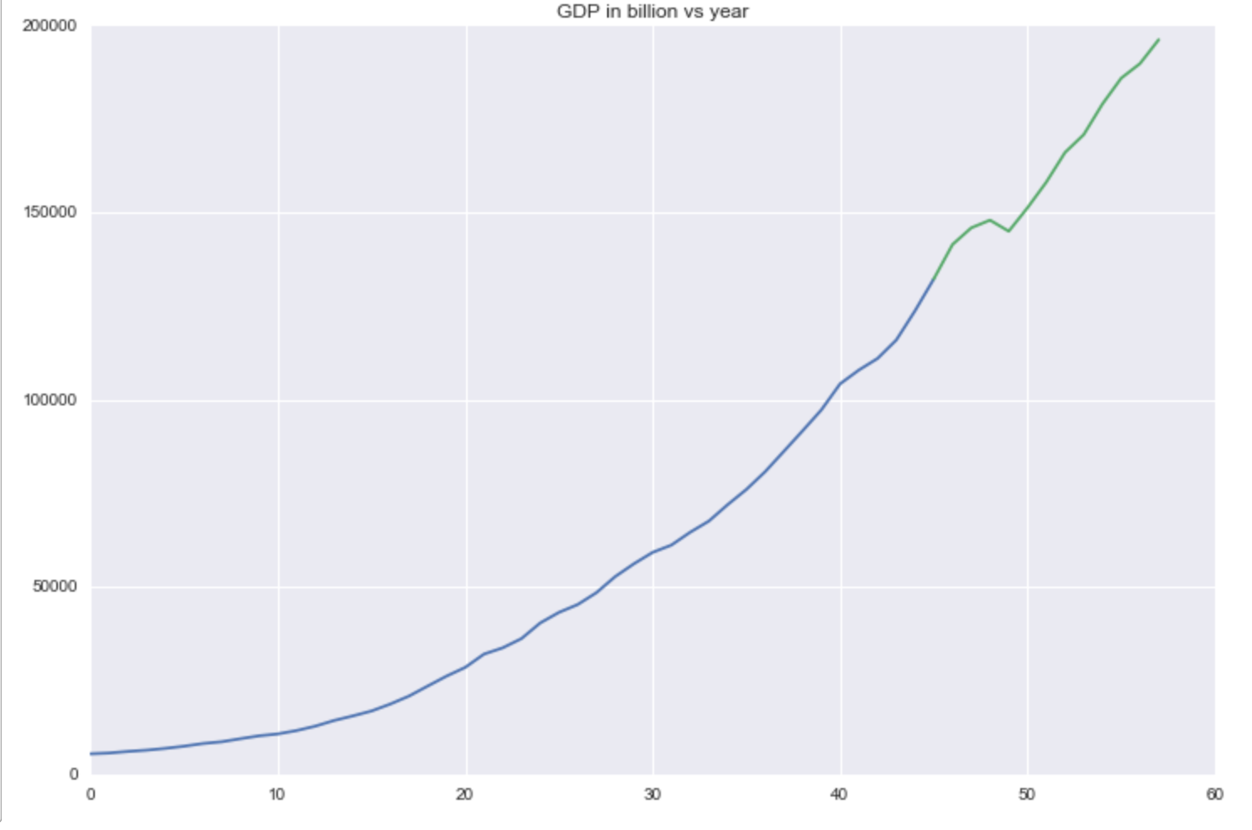
Time series based analysis
1960 1969 1980 1989 2000 2009 2017

Slide 13
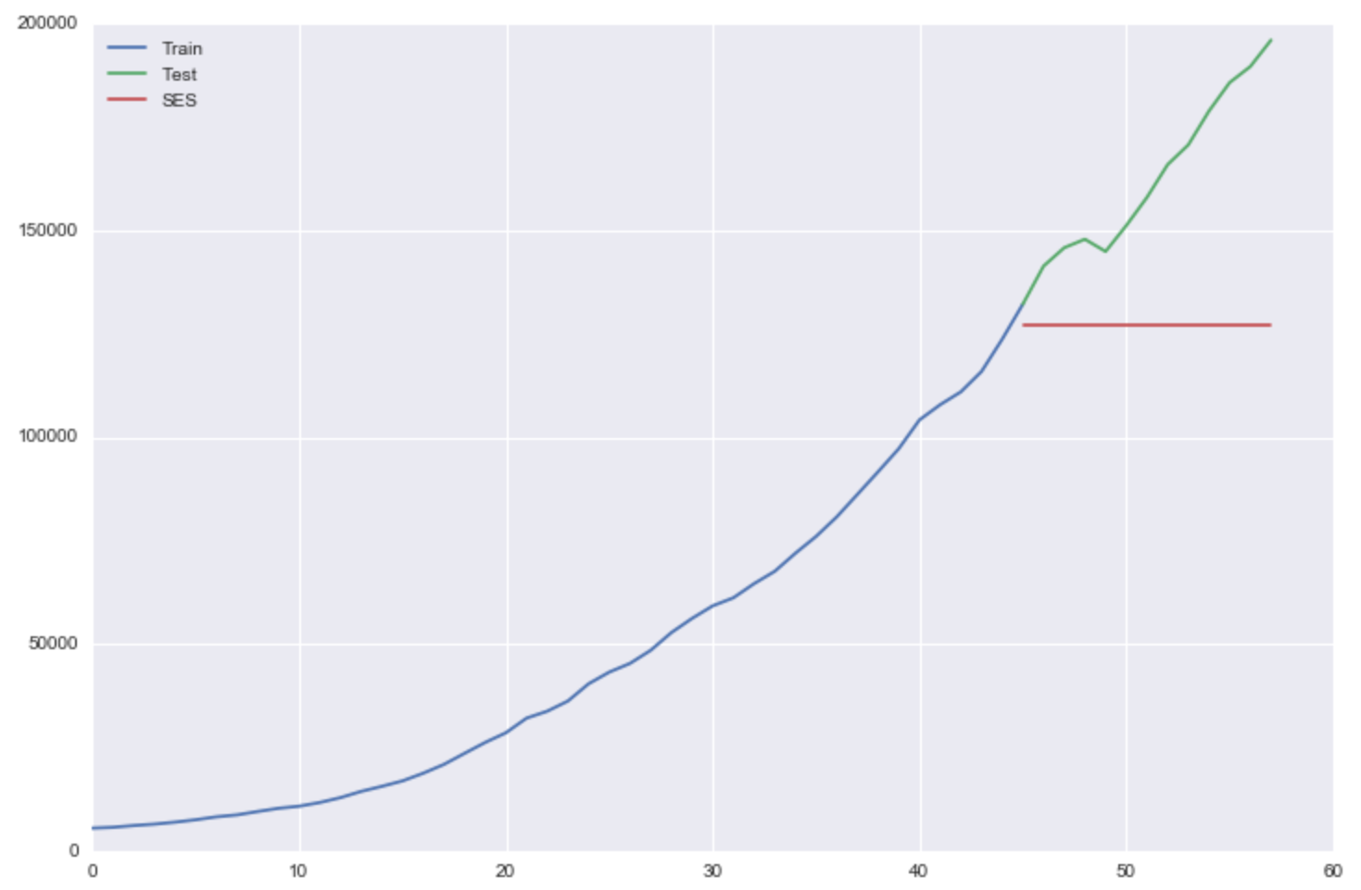
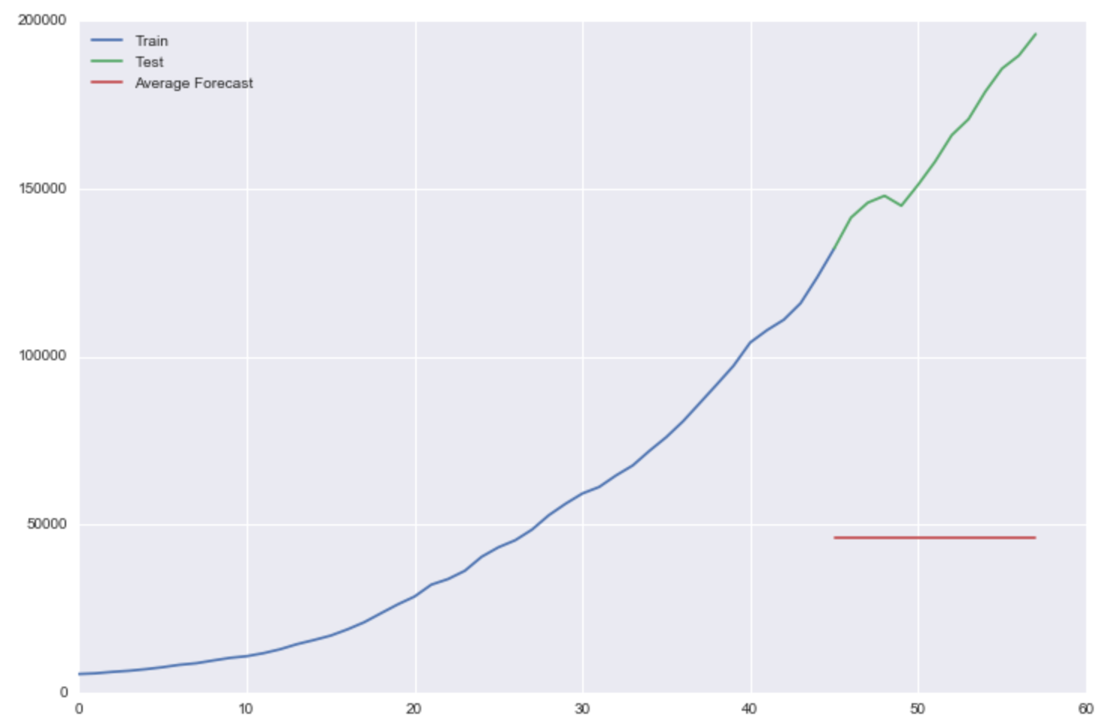
Time series based analysis
Simple average
Simple Exponential Smoothing
1960 1969 1980 1989 2000 2009 2017
1960 1969 1980 1989 2000 2009 2017

Slide 14
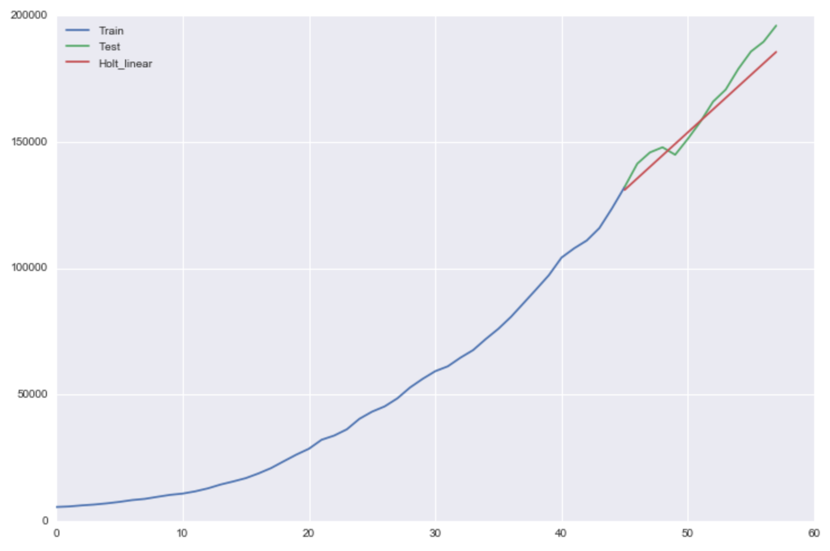
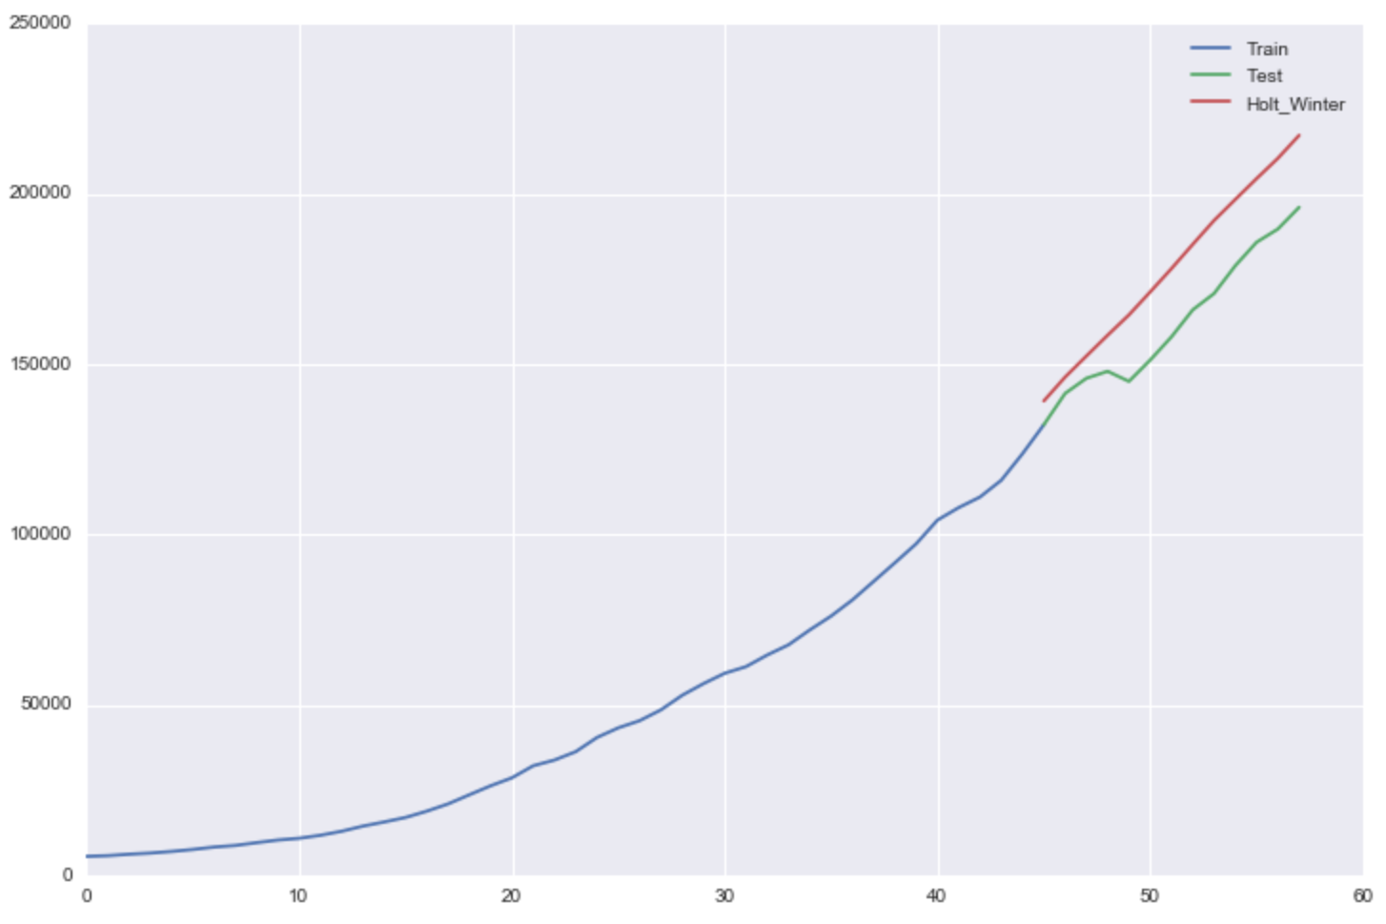
Time series based analysis
Linear Trend Method
Holt-Winters Method
1960 1969 1980 1989 2000 2009 2017
1960 1969 1980 1989 2000 2009 2017

Slide 15
 | RMS
Simple average | 117913.16888043906
Simple Exponential Smoothing | 40285.45776685907
Linear Trend Method | 5808.804948629779
Holt-Winters Method | 17200.89175618352

Slide 16
From Time series to Supervised learning

